Slide 1
SQL Training

Slide 2
Contents
Relational database overview
SQL overview
Access overview
Resources
Building a relational database in access
SQL queries – SQL Structured Query Language
Access Reports (This might useful for model output)
Your model – how it works/how it might work with SQL

Slide 3
Relational Database
IBM - A relational database organizes data into tables which can be linked—or related—based on data common to each. This capability enables you to retrieve an entirely new table from data in one or more tables with a single query. It also allows you and your business to better understand the relationships among all available data and gain new insights for making better decisions or identifying new opportunities.
A set of tables that are structured and related in some logical way
The structure/relationships are often called the “data models” or schemas
Linking between tables uses a system of “primary keys” and “foreign keys”

Slide 4
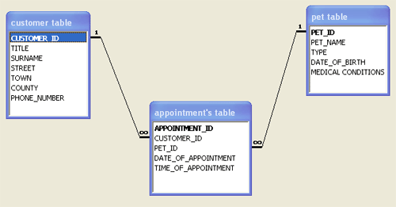
Example data model (vets!)
Primary key
Primary key
Primary key
Foreign key
Important: One to many relationships/IDs reduce data replication
Google 3rd Normal Form if you really want to get into doing this “properly”

Slide 5
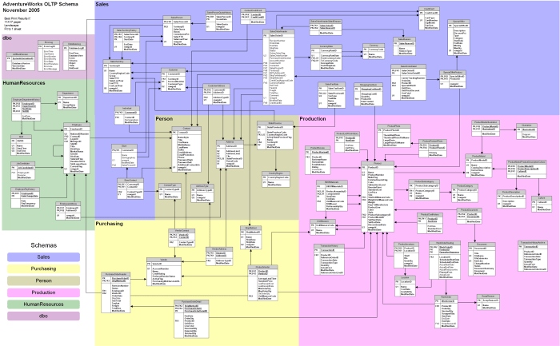
Microsoft Training Database

Slide 6
SQL – Structured Query Language
Used to extract and manipulate data in a relational database
Select + Where clause – subset based on criteria
Select + “Group By” aggregate – e.g. average/sum/min etc with a subset
Joins – extract data from related tables
Unions – extend created tables
Create – create a new table
Update – add column etc

Slide 7
Access – data base, queries and more in one file
Function
Access
Input Data
Forms/Import
Structure Data
Related Tables (data base)
Flow of
Data
VBA
Query/Process Data
Queries (SQL)
Report
Reports
Export

Slide 8
Resources
Access – I based the “access bit” on:
Lesson 1: https://www.youtube.com/watch?v=1IA4SeajZRw
Lesson 2: https://www.youtube.com/watch?v=bqQ-eKMxk6Q&list=PLyy-LLqj7iSbjw0SZOn2cZUxURPkIc1D7&index=14
The files are here: https://kaceli.com/a/access2016/
These looked good:
https://support.microsoft.com/en-us/office/access-video-training-a5ffb1ef-4cc4-4d79-a862-e2dda6ef38e6
https://www.youtube.com/watch?v=PBhftKTmdHI&list=PL4UezTfGBADBmCOYtQ8QohflQNY1y3oE7
SQL
Good Reference: https://www.w3schools.com/sql/sql_case.asp
Good Course: https://www.edx.org/course/querying-data-with-transact-sql-2
Course is fair bit more involved than what we have done. It used to be possible to do it for free if by selecting audit when enrolling – doesn’t use access

Slide 9

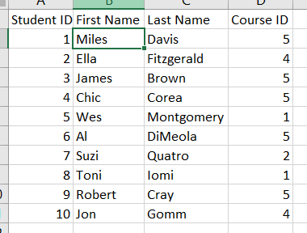
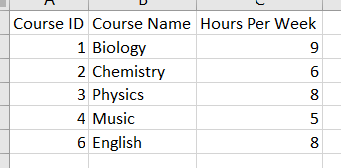
Joins Demo

